Slide 1

Overview/Introduction
A ski trip recommendation app that gives user information about:
Snow Condition
Weather
Crowd Index
Hotel Availability
Traffic Condition
Travel Time
Overall Recommendation Index
Motivation/Purpose

Slide 2
App Walkthrough
Role Play is a good approach!

Slide 3
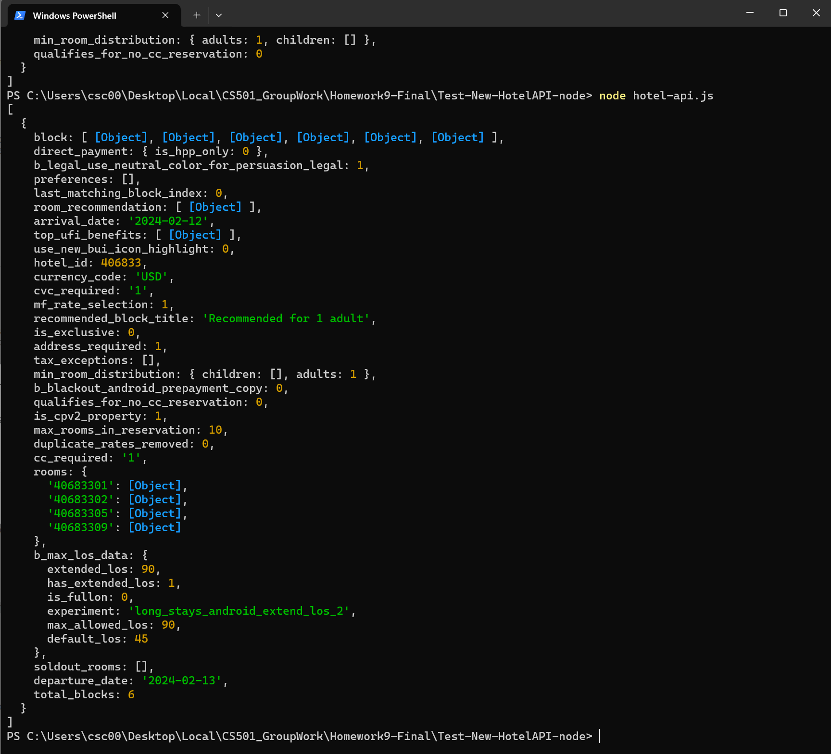
Roadblock 1
Hotel API does not have direct hotel availability data
Booking.com Room list of the hotel API Response
Workaround
Make two API calls:
1. Get selected date room list
2. Get 3 month later room list – assume this list reflect empty status
room_count
__________
3m_room_count
X100%

Slide 4
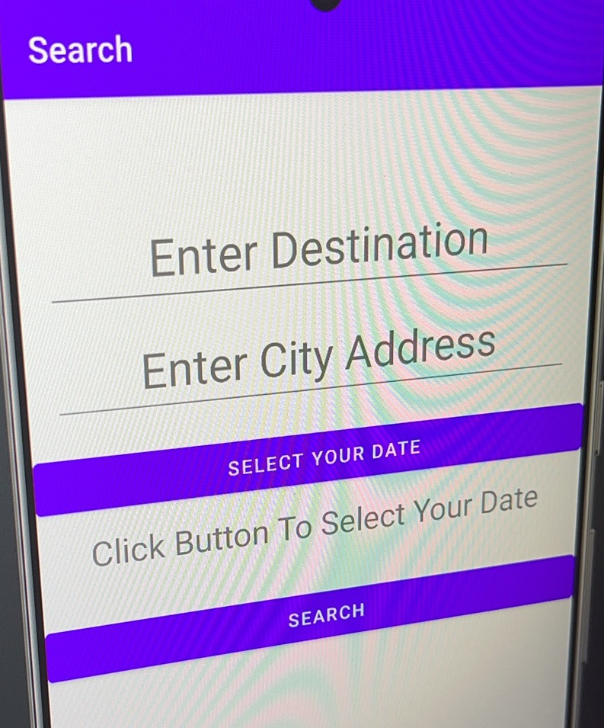
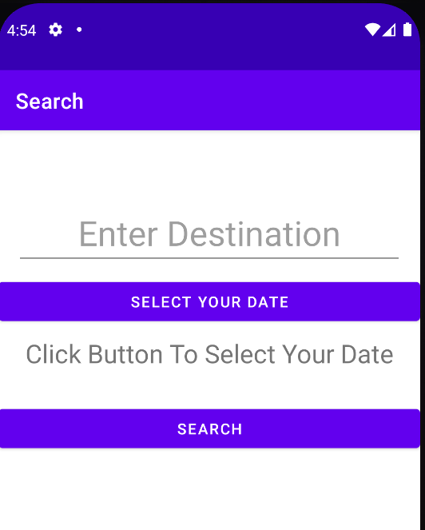
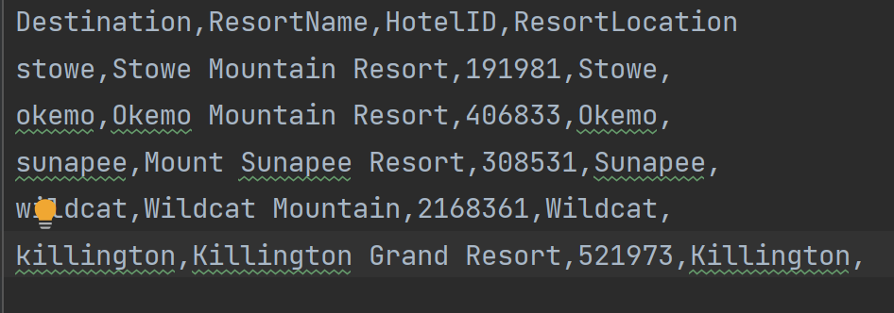
Roadblock 2
Weather API Integration
1. Weather API need to receive city name.
2. Users input ski resort name.
Workaround
1. Considered entering both resort name and city name.
× Simplicity of use
2. Save the city name corresponding to the ski resort in the database and call.
Implementation Details

Slide 5
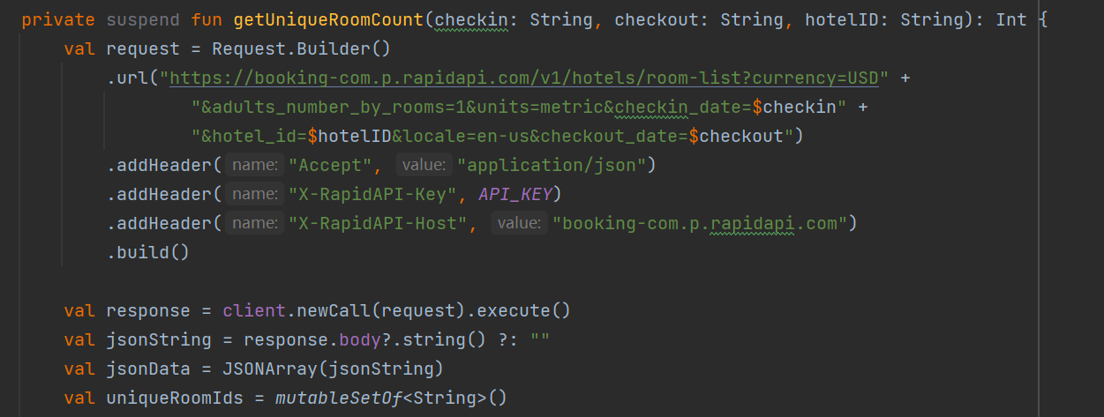
Booking.com Room list of the hotel API Response
Roadblock 3
No API handbook for Booking.com API:
1. Not available for general public
2. Different hotel have different booking policy
Workaround
1. Booking.com Search Hotel by Coordinates API
2. Google Map

Slide 6
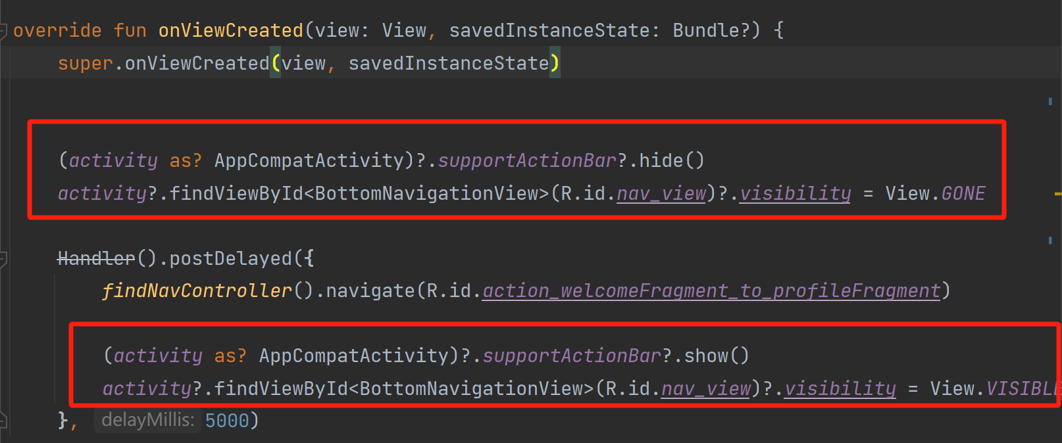
Roadblock 4
Welcome Page
1. Hide action bar and nevigation bar.
2. How to stay for some periods and continue to show main page.
Implementation Details
Workaround
1. The bottom navigation bar is located using its ID (R.id.nav_view) and its visibility is set to View.GONE to hide it.
2. When navigating away from the WelcomeFragment, the visibility of the bottom navigation bar is restored to View.VISIBLE.

Slide 7
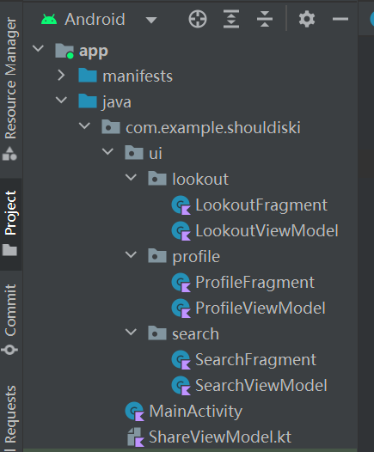
Roadblock 5
Data sharing between fragments
Workaround
1. Use ShareViewModel
2. Use LiveData and Observe

Slide 8

Roadblock 6
Database Setup
1. Supported Resort Database
2. User Preference Storage
Workaround
1. Two database with SQLite – Resort and Preference
2. YouTube Tutorial
3. Slightly different for two database and handling

Slide 9
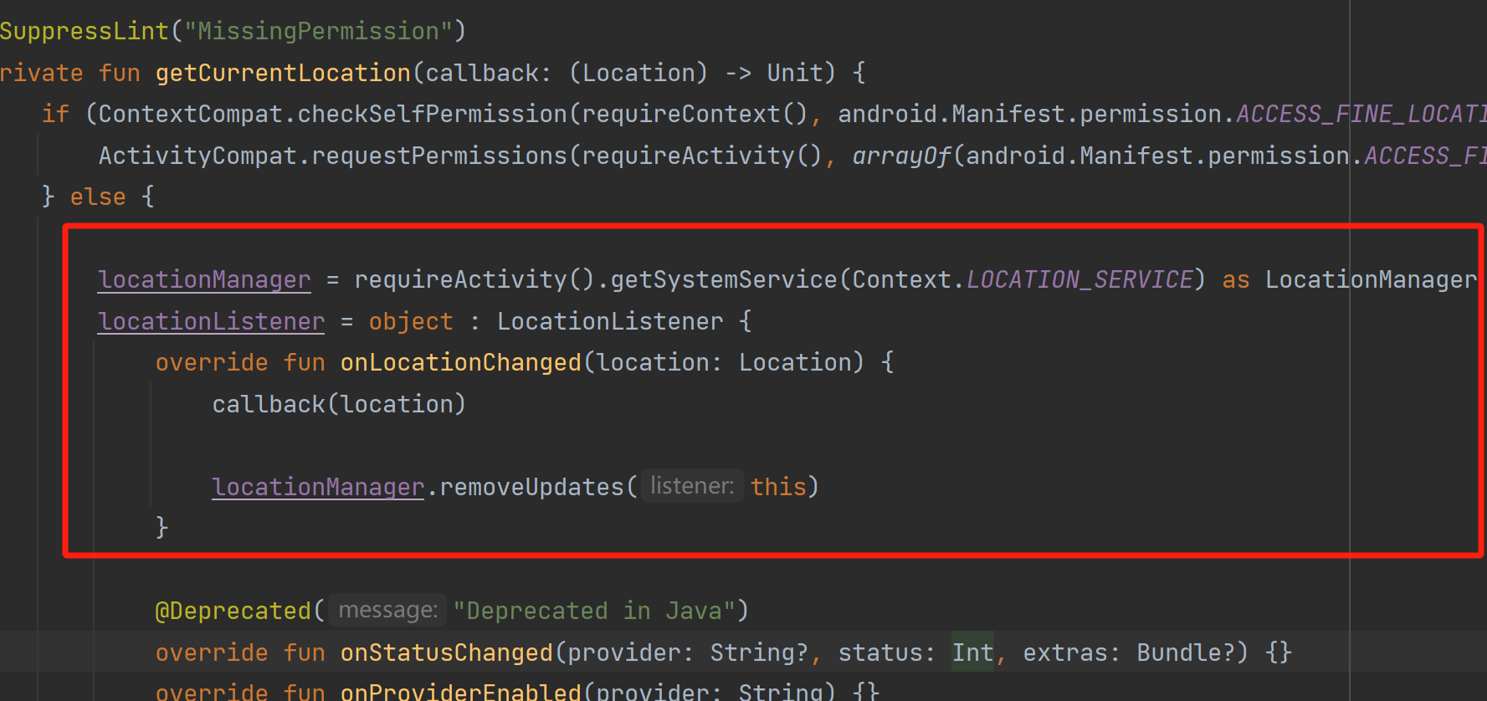
Roadblock 7
Current Location
Unstable to get current location.
getLastKnownLocation vs LocationListener
Implementation Details
Workaround
1. I first used getLastKnownLocation ,which might return null if there's no recent location data available.
2. A more reliable approach is to request location updates.

Slide 10
Other Roadblocks...
1. How to center-align text.
2. How to change icon color based on API return content
3. ......

Slide 11
Implementation Details, Including:
Roadblocks/Surprises/Workarounds
Roadblocks:
Database build up
Surprises : Hotel(API server outrage)
Workarounds

Slide 12
Implementation Details
What would you do differently?

Slide 13
Implementation Details
Future Work
Implement language switching system

Slide 14
Demo

Slide 15
Summarize:
Our project involved the development of 4 APIs, each presenting its own set of challenges. Notably, the Map API and Hotel API were particularly complex, requiring us to overcome numerous difficulties. During the development of the Weather Query API, I addressed over a dozen issues, experimenting with three different APIs before finally arriving at an ideal solution.

Slide 16
Reference
1. Android Tutorial (Kotlin) - 30 - SQLite Database Creation and Insertion - YouTube
2. https://rapidapi.com/weatherapi/api/weatherapi-com/
3. https://rapidapi.com/letscrape-6bRBa3QguO5/api/driving-directions1

